Slide 1
Customer Churn Prediction – Capstone Project
End-to-End Data Science Project
3-Month Learning Journey Outcome
Tools: Python, Machine Learning, Flask

Slide 2
Problem Statement
Customer churn leads to revenue loss
Retention is cheaper than acquisition
Need early churn prediction
Goal: Classify churn vs non-churn customers

Slide 3
Dataset Overview
Customer demographic and usage data
Numerical and categorical features
Target variable: Churn (0 = No, 1 = Yes)
Dataset cleaned and validated

Slide 4
Exploratory Data Analysis (EDA)
Analyzed churn distribution
Studied tenure vs churn
Charges impact on churn
Used bar charts and heatmaps

Slide 5
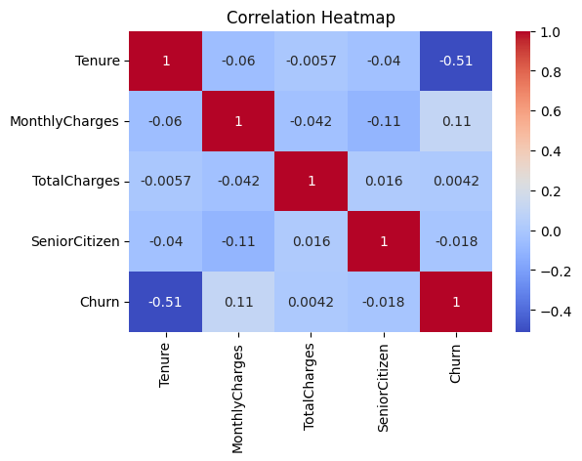

Slide 6
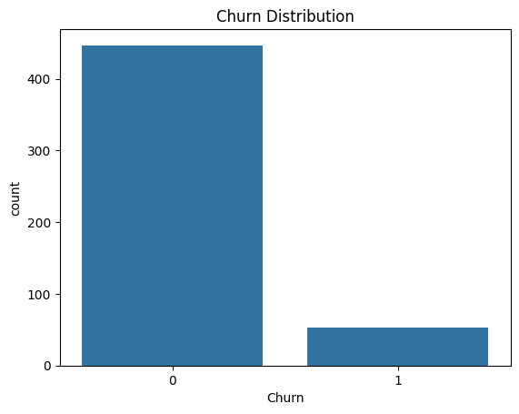

Slide 7
Data Preprocessing
Removed CustomerID
Handled missing values
Converted data types
One-hot encoded categorical variables
Ensured numerical dataset

Slide 8
Model Selection
Compared multiple models
Selected Random Forest Classifier
Handles non-linear relationships
Reduces overfitting
High accuracy and robustness

Slide 9
Model Performance
Train-test split evaluation
Metrics: Accuracy, Precision, Recall, F1-score
Achieved ~85% accuracy
Good generalization

Slide 10
Deployment
Model deployed using Flask
REST API for predictions
Simple web interface
Real-time churn prediction

Slide 11
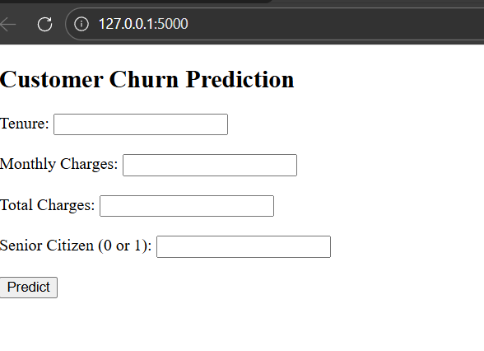

Slide 12
Business Insights
Low tenure increases churn risk
High charges increase churn
Contract type influences churn
Billing preference impacts churn

Slide 13
Recommendations
Offer discounts to high-risk customers
Improve onboarding process
Introduce loyalty programs
Flexible pricing plans

Slide 14
Conclusion
ML predicts churn effectively
Helps proactive decision-making
End-to-end workflow demonstrated
Industry-ready project
https://github.com/Shahulshibin/projects

